Slide 1
Hi Bong, good afternoon. I have one project develop for IGS Team for free.
That just small project and develop by Heng Thirith from IGS.
Subject : Web Application Manage case

Slide 2
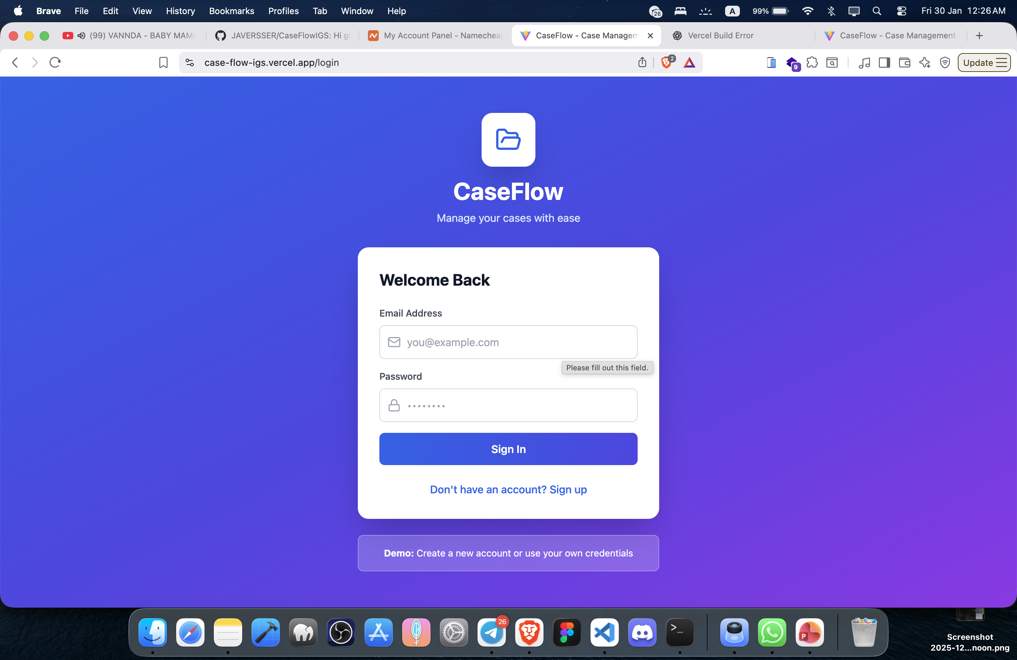

Slide 3
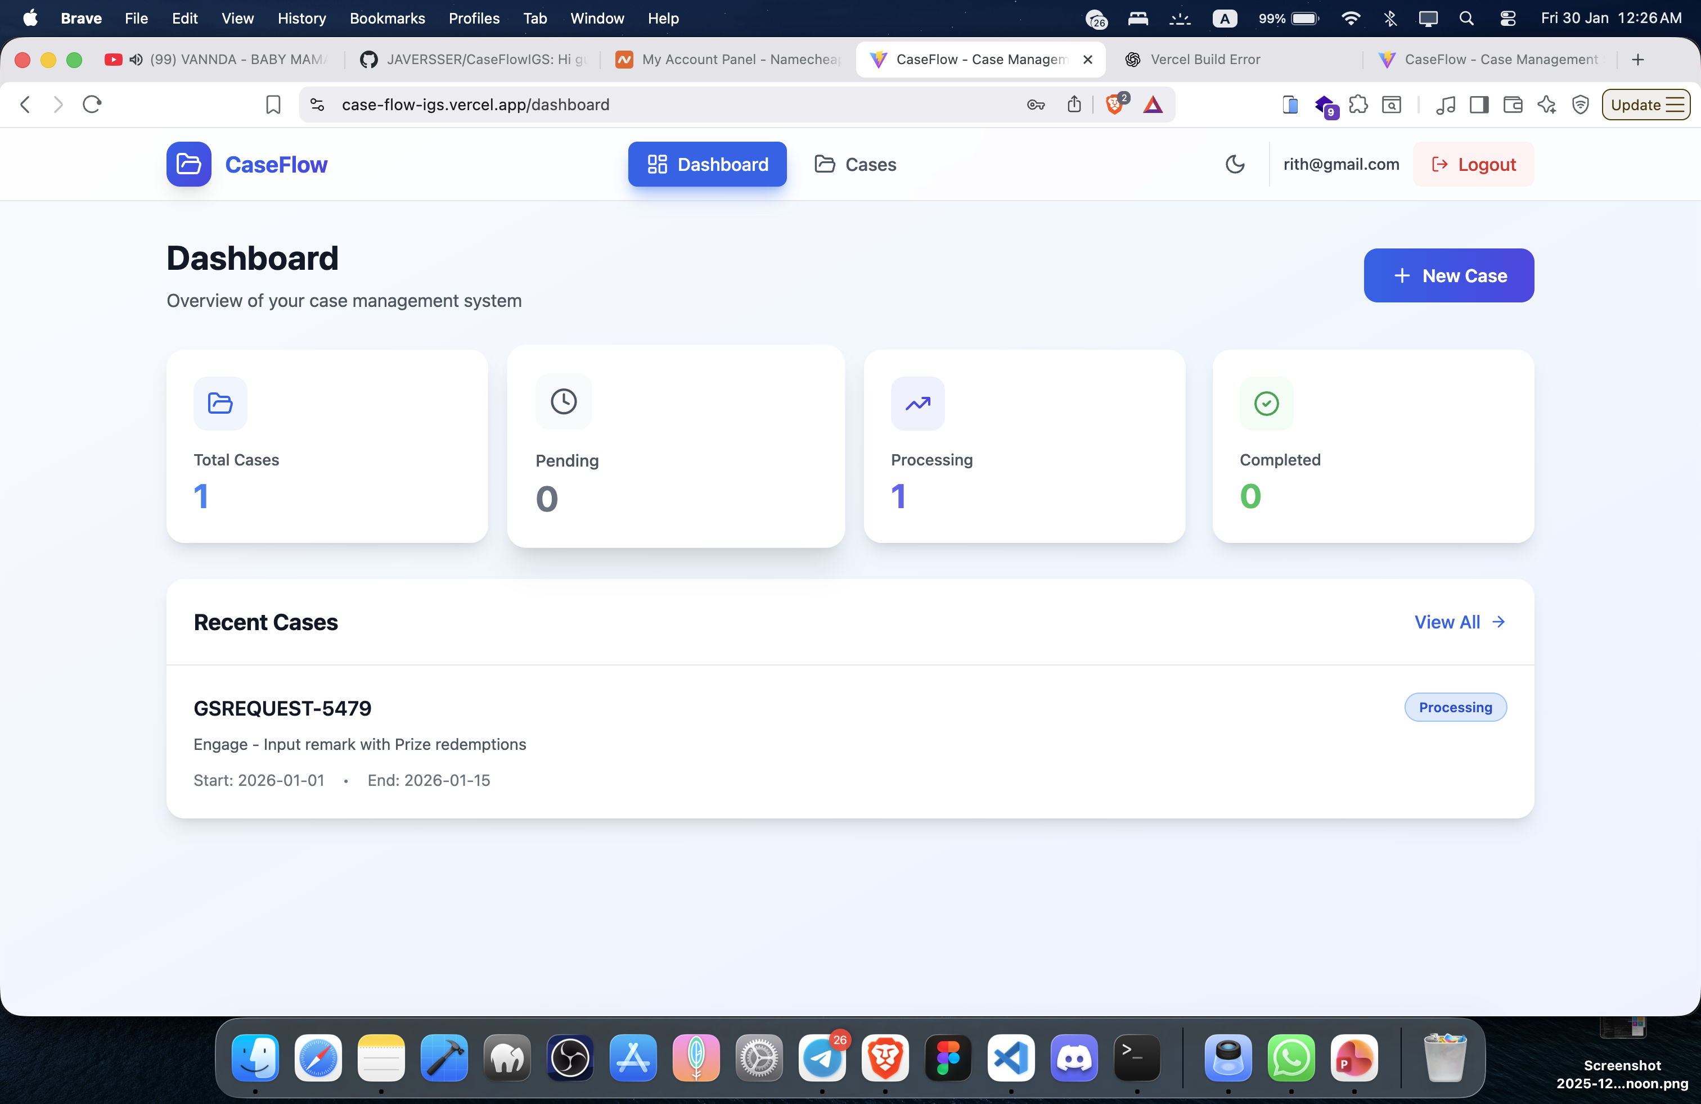

Slide 4
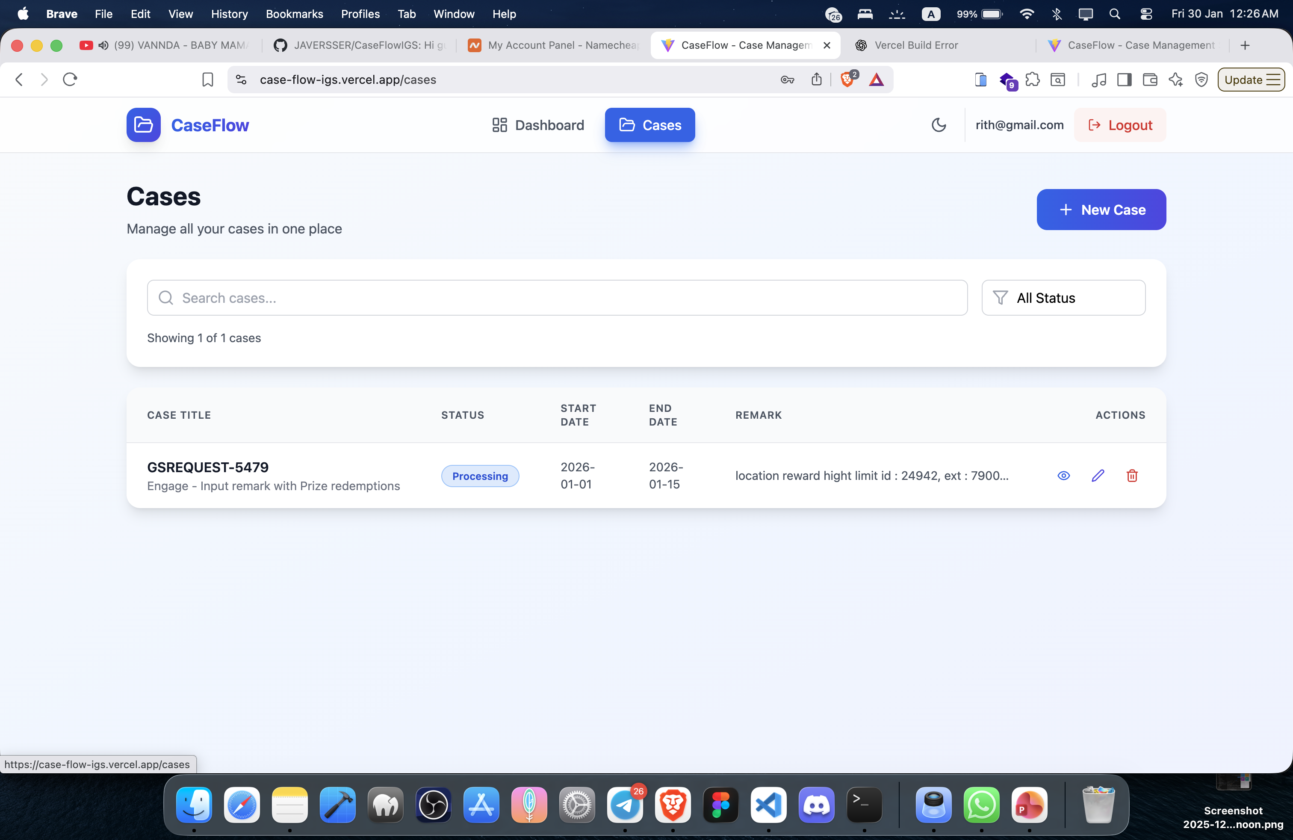

Slide 5
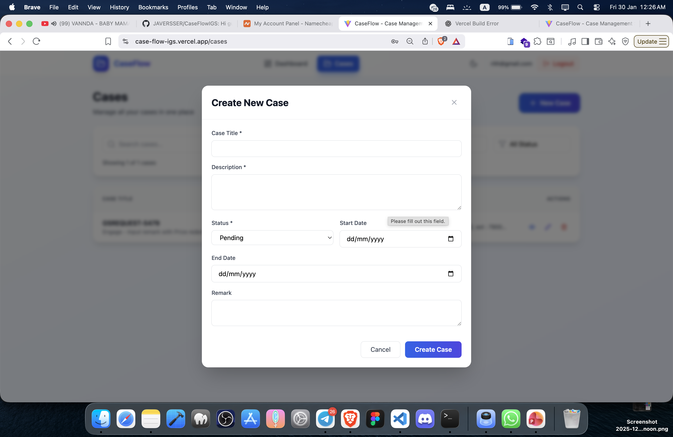

Slide 6
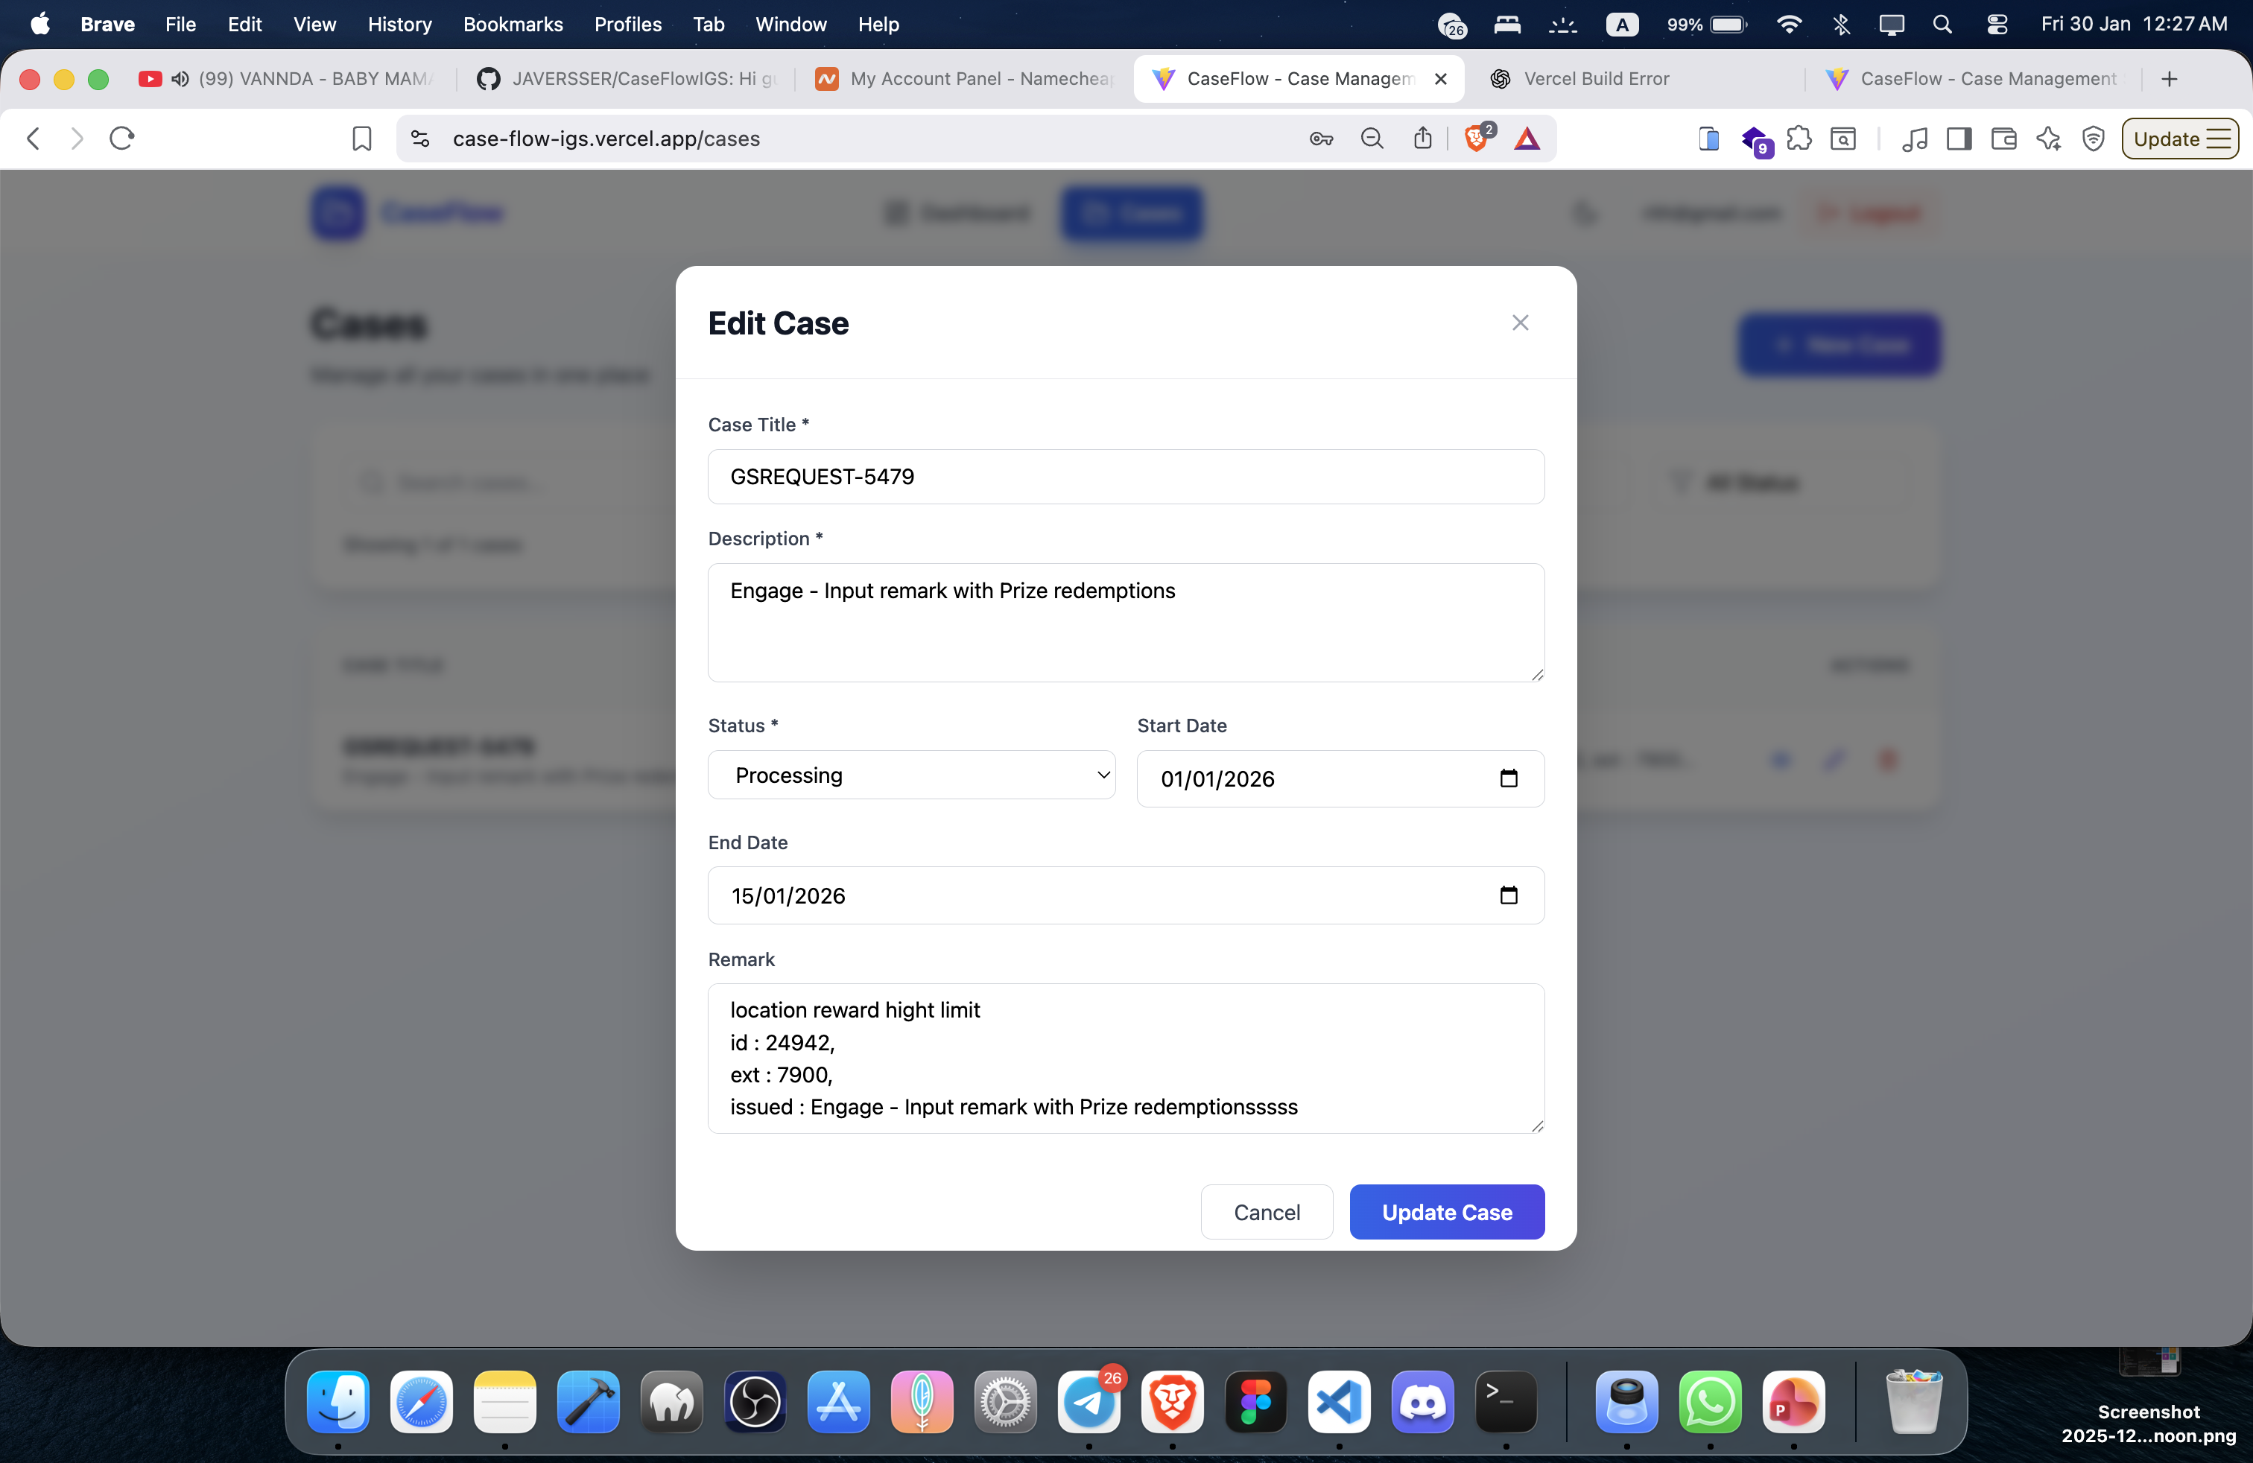

Slide 7
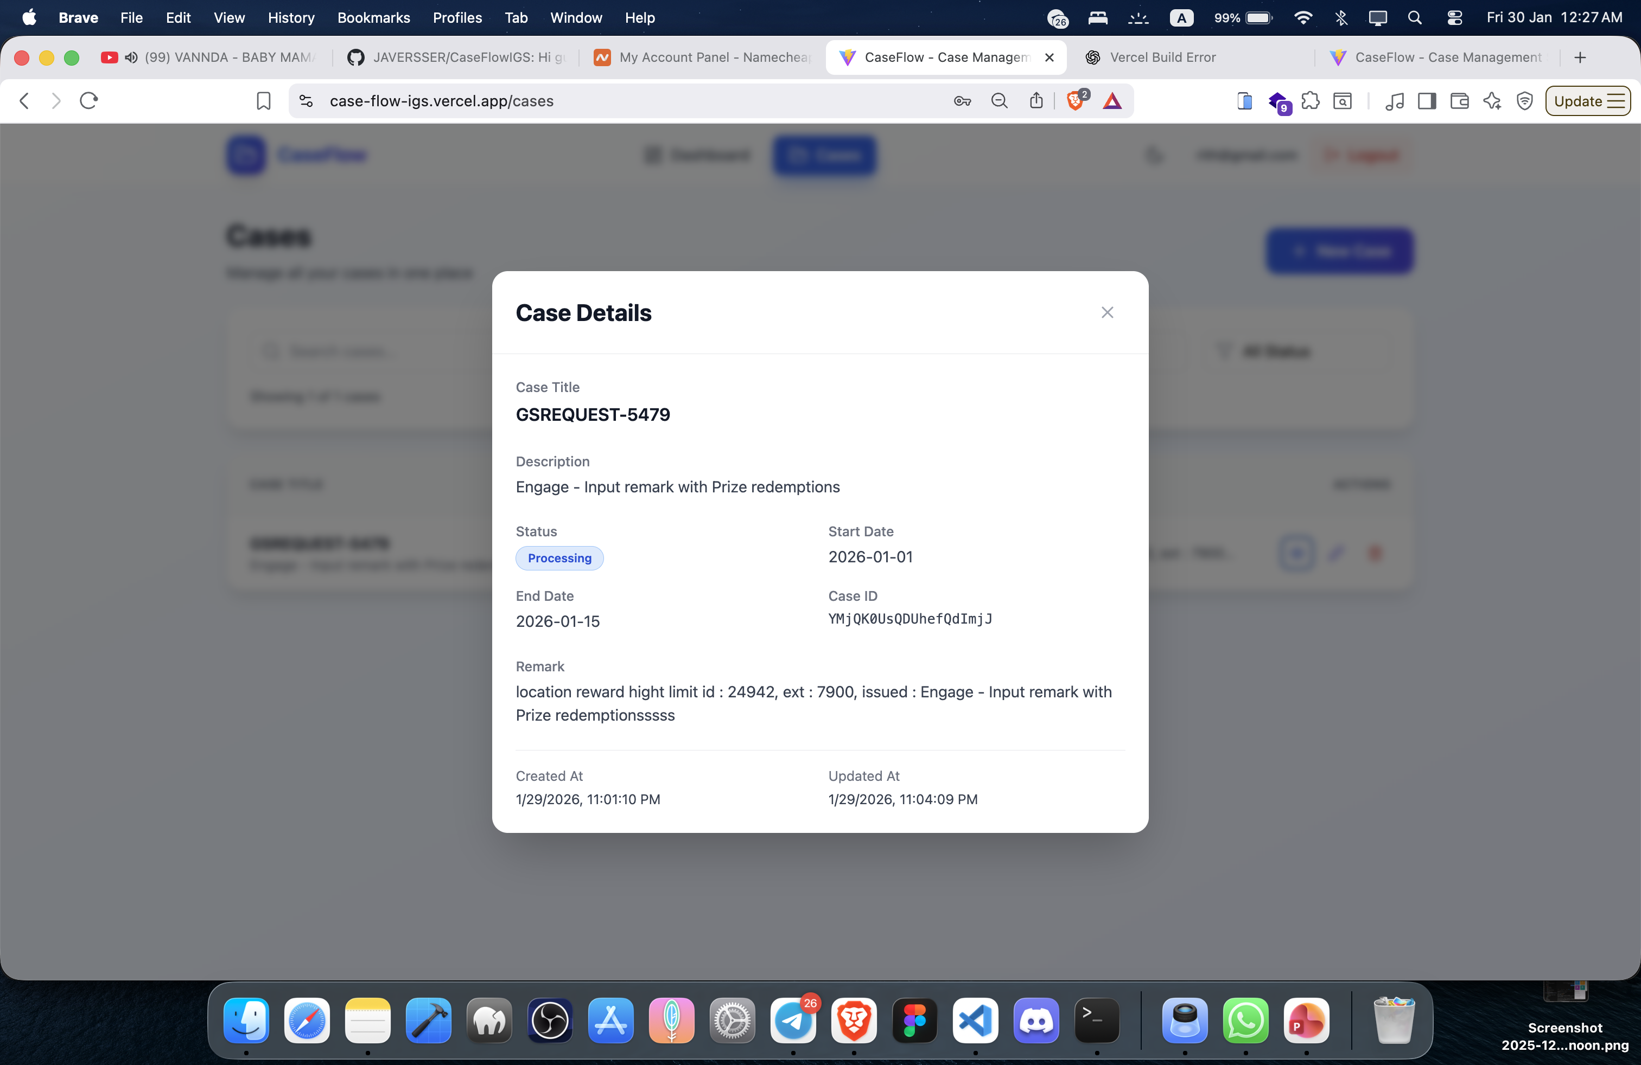

Slide 8
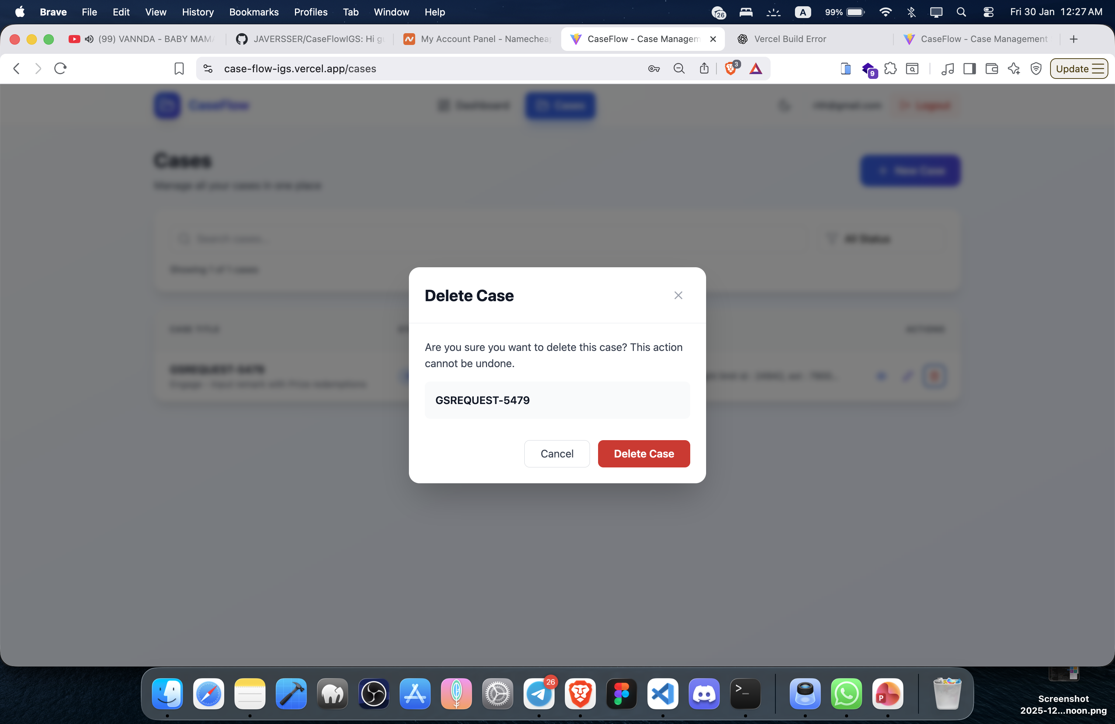

Slide 9
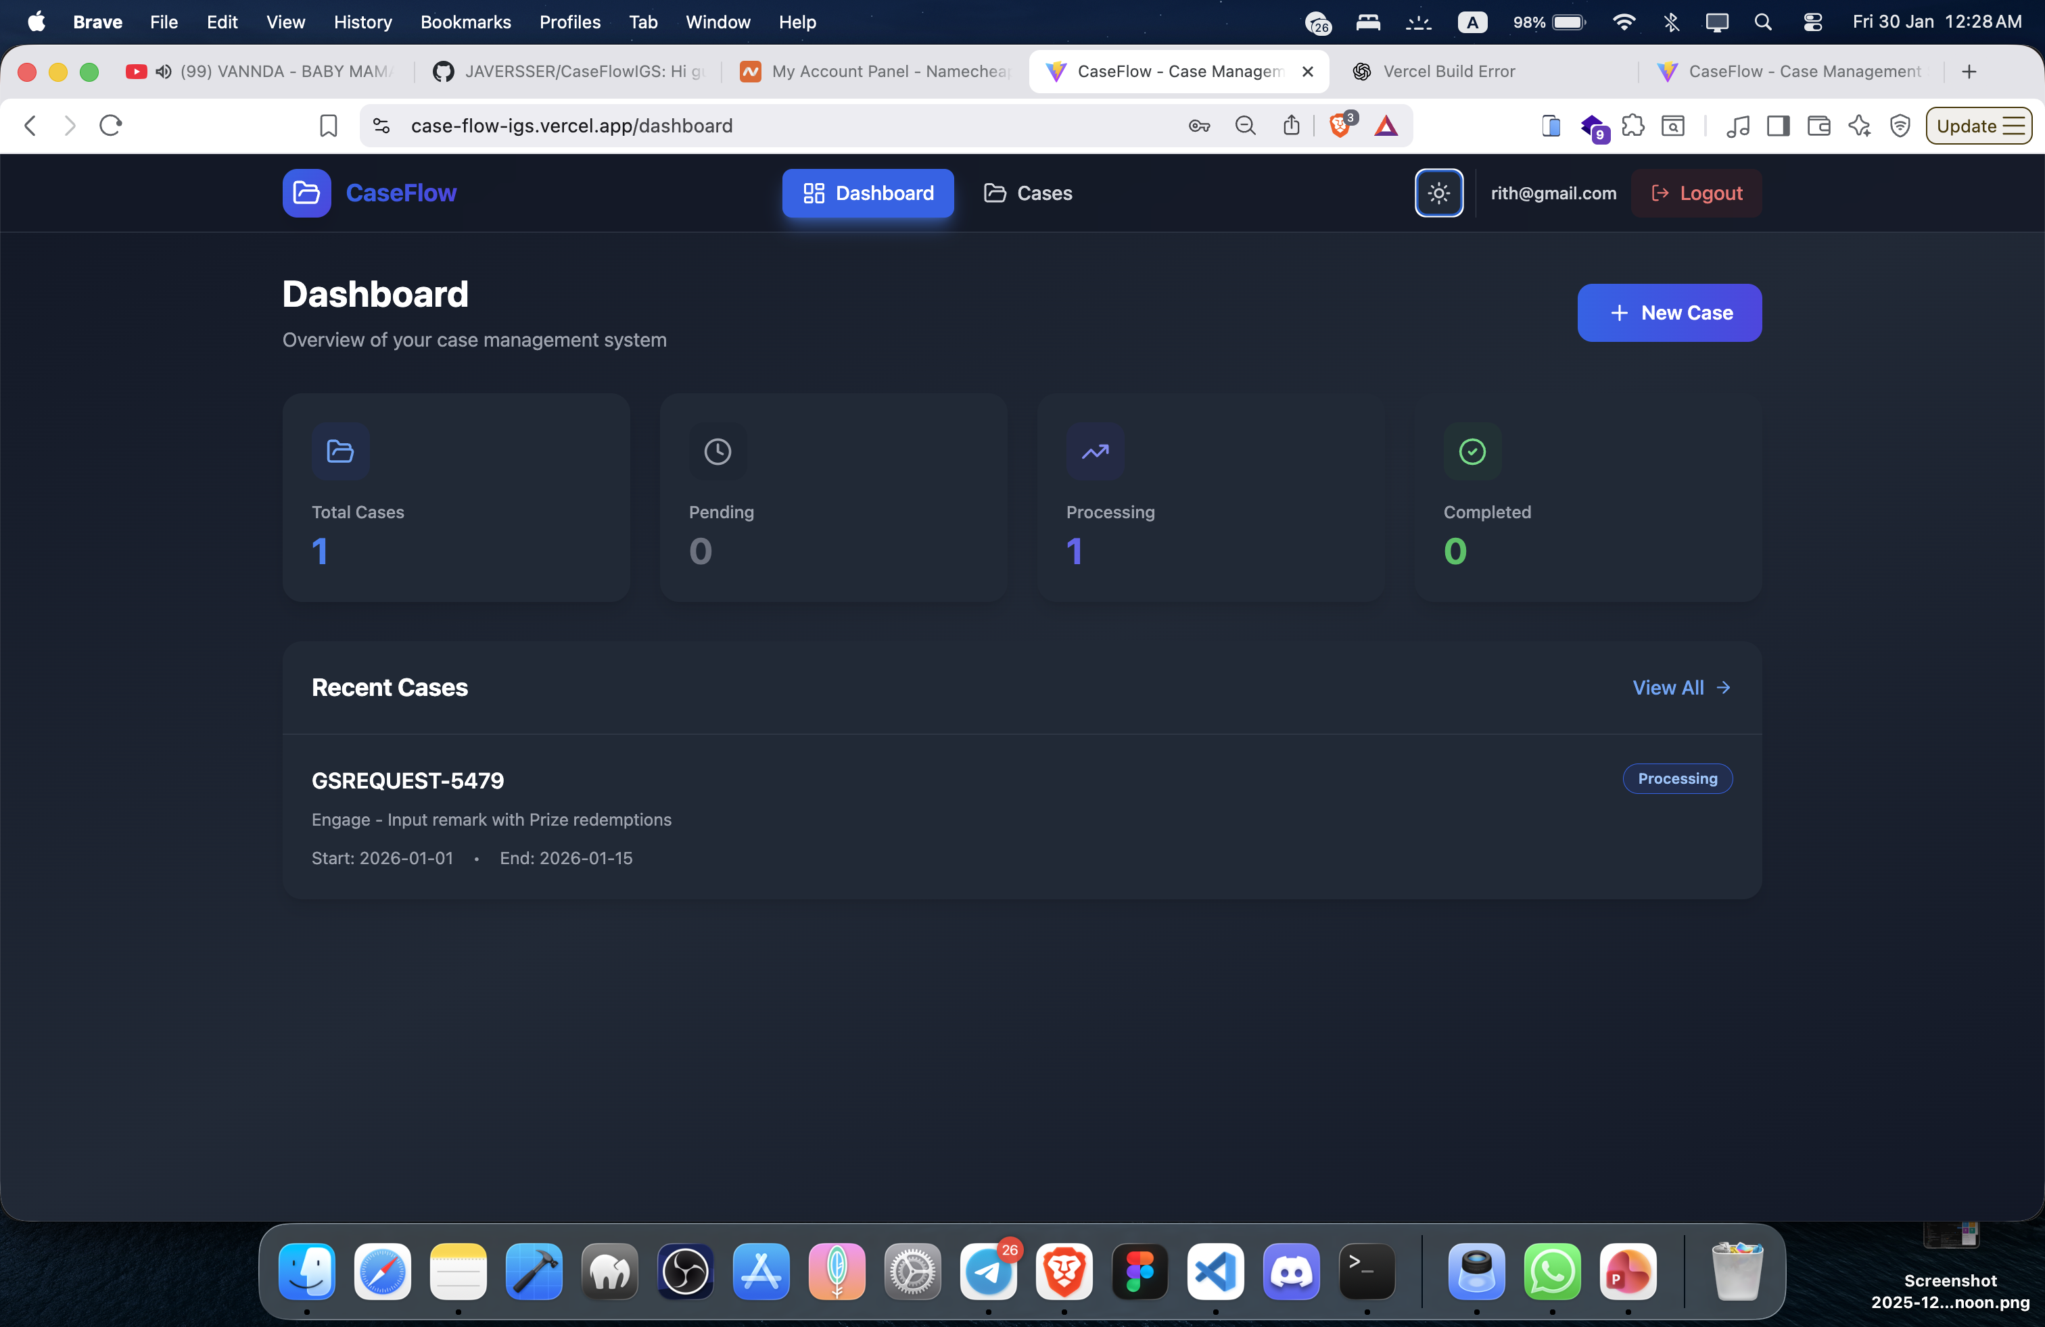

Slide 10
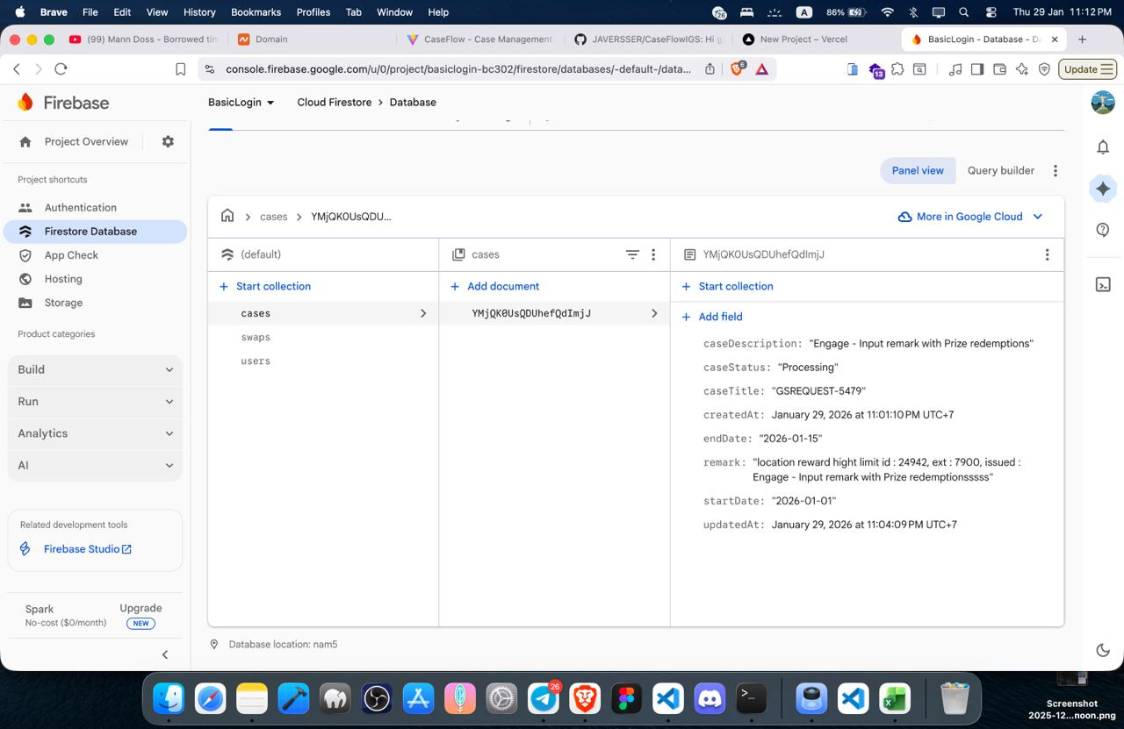

Slide 11
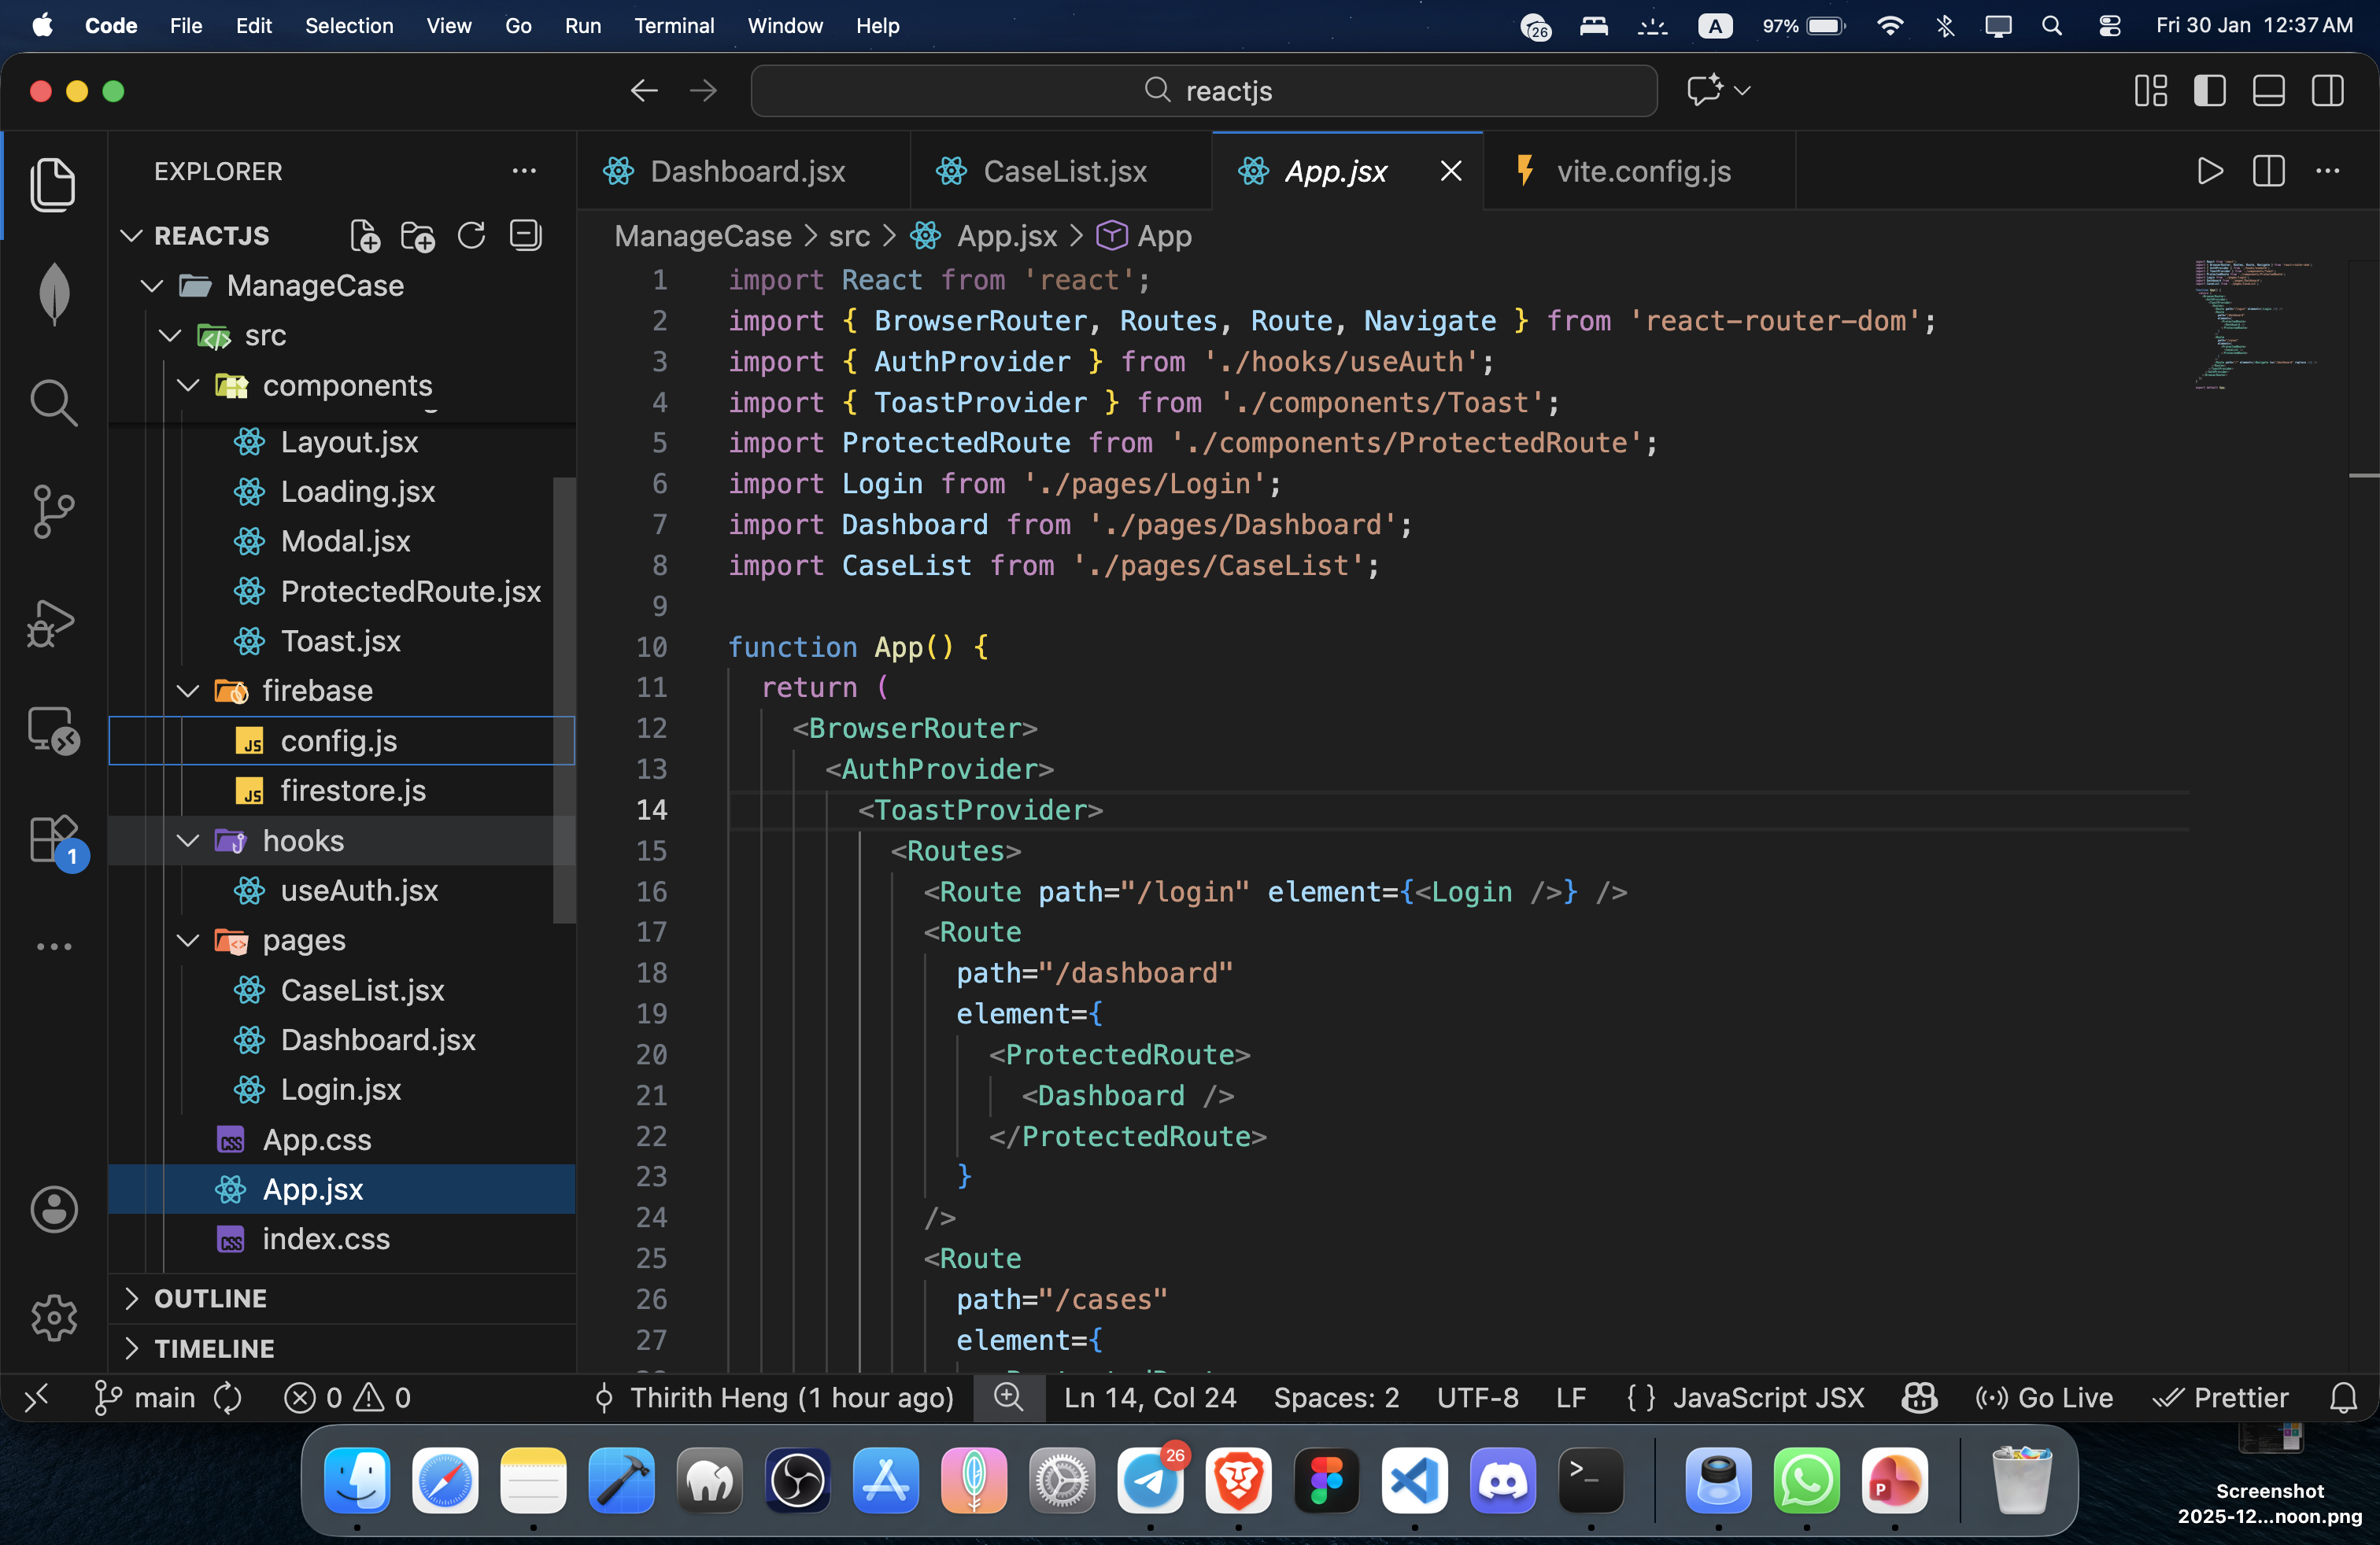

Slide 12
Thank you so much for listening
and please enjoy My Demo project
Notes:
Caseflowigs.site

